Slide 1
Verify Arbiter
Driving Innovations™
Jack Chang
2018-03-02

Slide 2
Arbiter
Fair arbiter
Pointer-Based Round-Robin
Strict priority arbiter
Weighted priority arbiter
Dynamic priority arbiter
FIFO-Based Priority
Credit-Based Priority

Slide 3
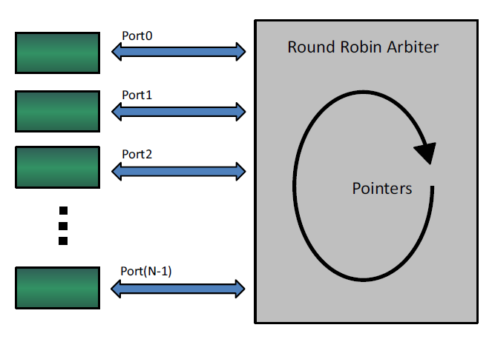
Pointer-Based Round-Robin
if port 0 was given a grant on the previous arbitration cycle, then port 1 will be designated the highest priority port for the next arbitration cycle
For any port request service, that particular port should receive a grant within N arbitration cycles

Slide 4

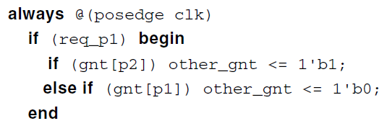

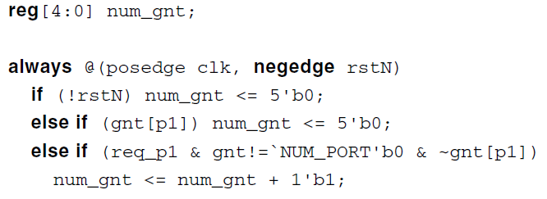
Fairness Round-Robin Requirements

Slide 5
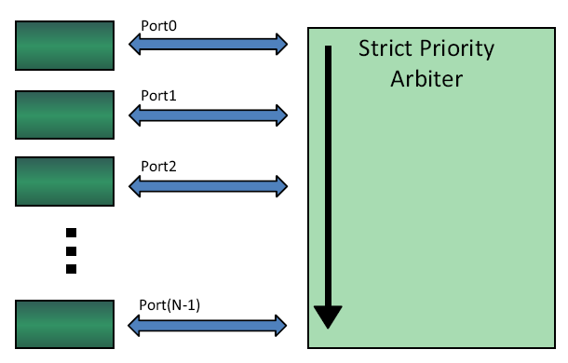
Strict Priority Arbiter
Always issues a grant to a requesting, higher-priority port before it issues a grant to a lower-priority port.
Assigns the highest priority to the lowest-numbered port
If there is a pending request on Port0, then it must be serviced before all other ports

Slide 6
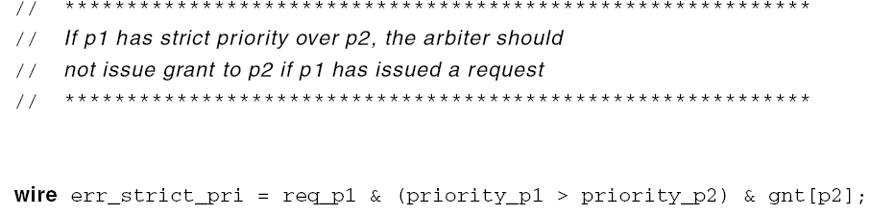
Strict Priority Arbiter Requirements

Slide 7
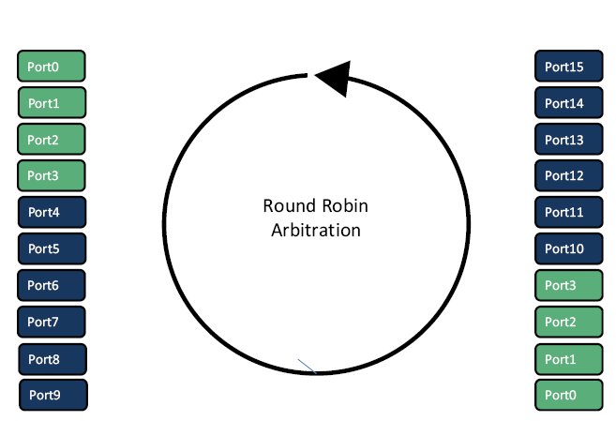
Weighted Priority Arbiter
A round-robin priority arbiter gives ports 0 through 3 twice as much bandwidth as ports 4 through 15
Requirements:
When Port0 to Port3 issue a request, they should get a grant before getting 10 other transfers.
When Port4 to Port15 issue a request, they should get a grant before getting 20 other transfers.
The number of transfers (grants) for a weighted priority requirements scheme can be generalized to total_weight/weight_of_port.

Slide 8
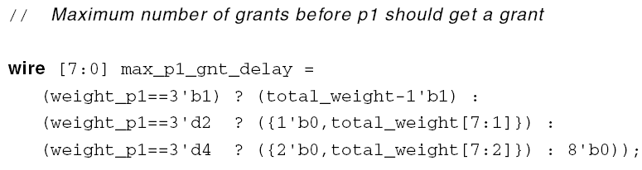
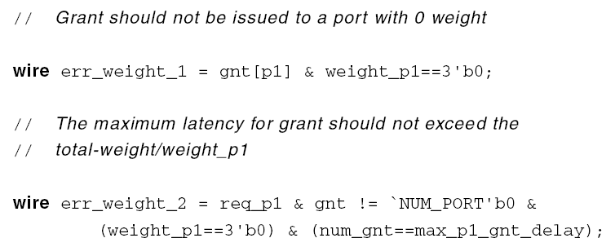
Weighted Priority Arbiter Requirements
-1’b1
-1’b1
weight_p1!=3’b0

Slide 9
Dynamic Priority Arbiter
The priority is changed dynamically.
FIFO-Based
Credit-Based
Priority arbiter requirements:
If there is only one port with high priority, it will always get the grant.
If there is more than one port with high priority, those ports will follow the round-robin fairness requirement.
If there is no port with high priority, all normal-priority ports will follow the round-robin fairness requirement.

Slide 10
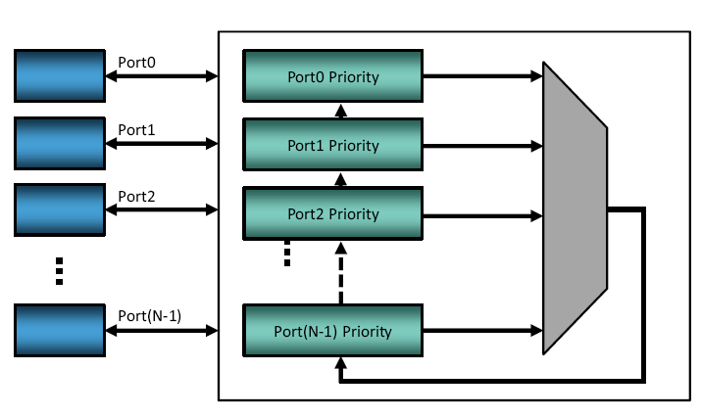
FIFO-Based Priority Arbiter
All ports are initially put into the normal-priority bracket and arbitrated using the round-robin scheme.
When the input FIFO for Port0 reaches the high-water mark, it sends a signal to elevate Port0 to the high-priority bracket.
The ports in the high-priority bracket have strict priority over the ones in the normal-priority bracket. After Port0 gets a grant, it will be placed back in the normal-priority bracket.

Slide 11
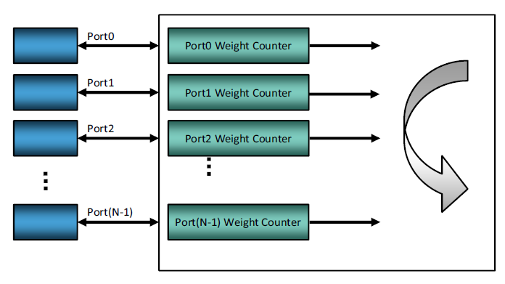
Credit-Based Priority Arbiter
If credit is available, each grant will decrement the credit by one.
If a credit refill condition occurs, the credit will be initialized.
All ports reach zero
All non-zero credit ports do not have a request

Slide 12
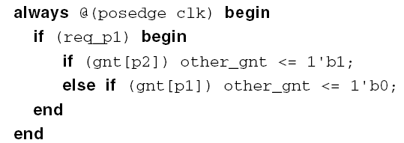

Dynamic Priority Arbiter Requirements

Slide 13
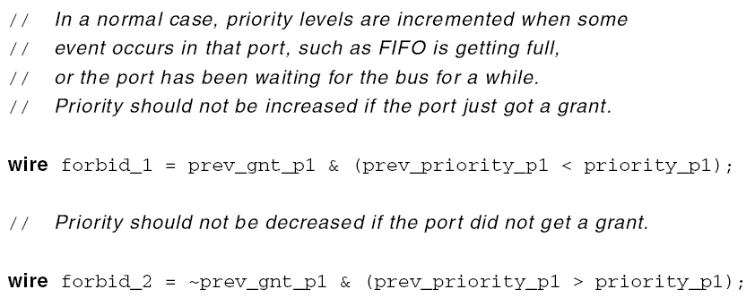
Dynamic Priority Arbiter Constraint

Slide 14

FIFO-Based Priority Requirements

Slide 15
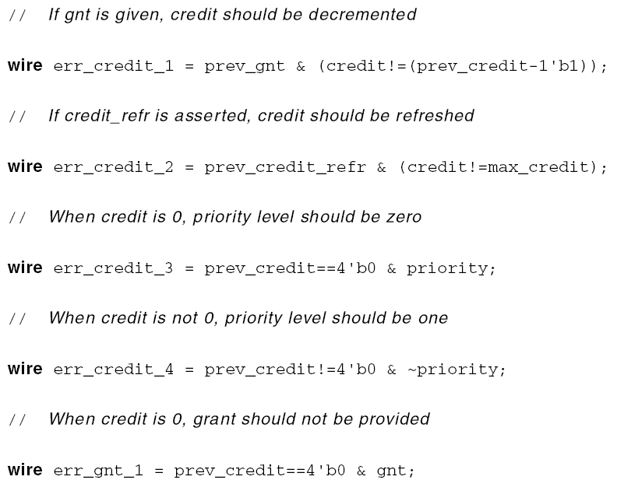
Credit-Based Priority Requirements

Slide 16
Thank You!

Slide 17
Reference
T:\vendors\Cadence\JasperGold\application_notes\
an_arbiter_fairness.pdf
an_arbiter_strict.pdf
an_arbiter_weighted.pdf
an_arbiter_dynamic.pdf
Notes:
17

